Slide 1
Hotel Smart Reservation System
FINAL PROJECT PRESENTATION
By:
Bishwas Niraula
&
Prakash Koju

Slide 2
Hotel Smart Reservation
(a Complete Hotel Solution)
Easy reservation process
Efficient Room management
Multi-Booking system for separate Date
Simple solution for complex scenario

Slide 3
Problem Statement
Manual/ Paper work to do hotel reservation system
Although there are some available system, they have Cranky and Outdated User Interface
Unable address user requirements
Ad-hoc approach and no resiliency

Slide 4
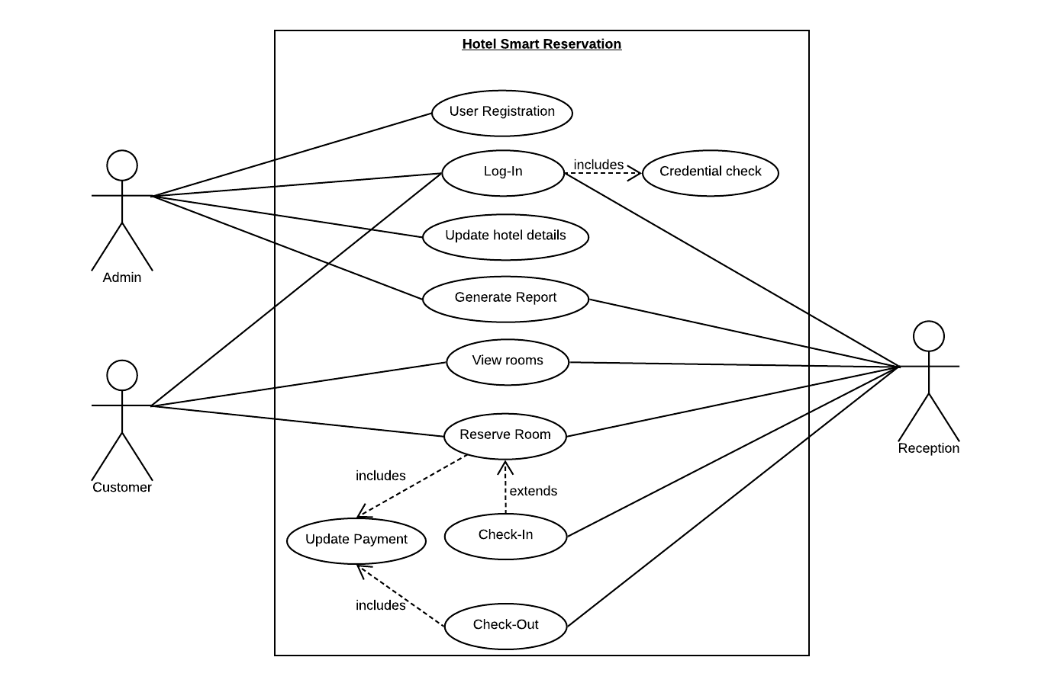
Use Case Diagram

Slide 5
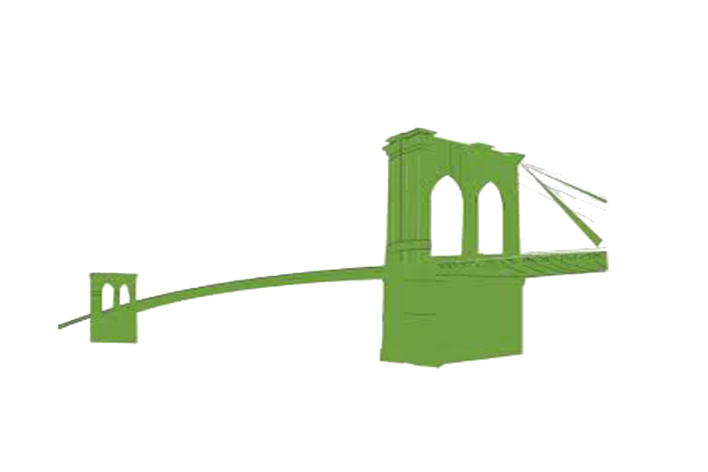
We have a solution
Hotel
Customer
HSR

Slide 6
Hotel Smart Reservation - SOLUTION
Systematic Hotel Data Management
Ease of Access
Good User Interface (UI-UX)
Iterative development approach and flexible solution to adjust with changing business scenario

Slide 7
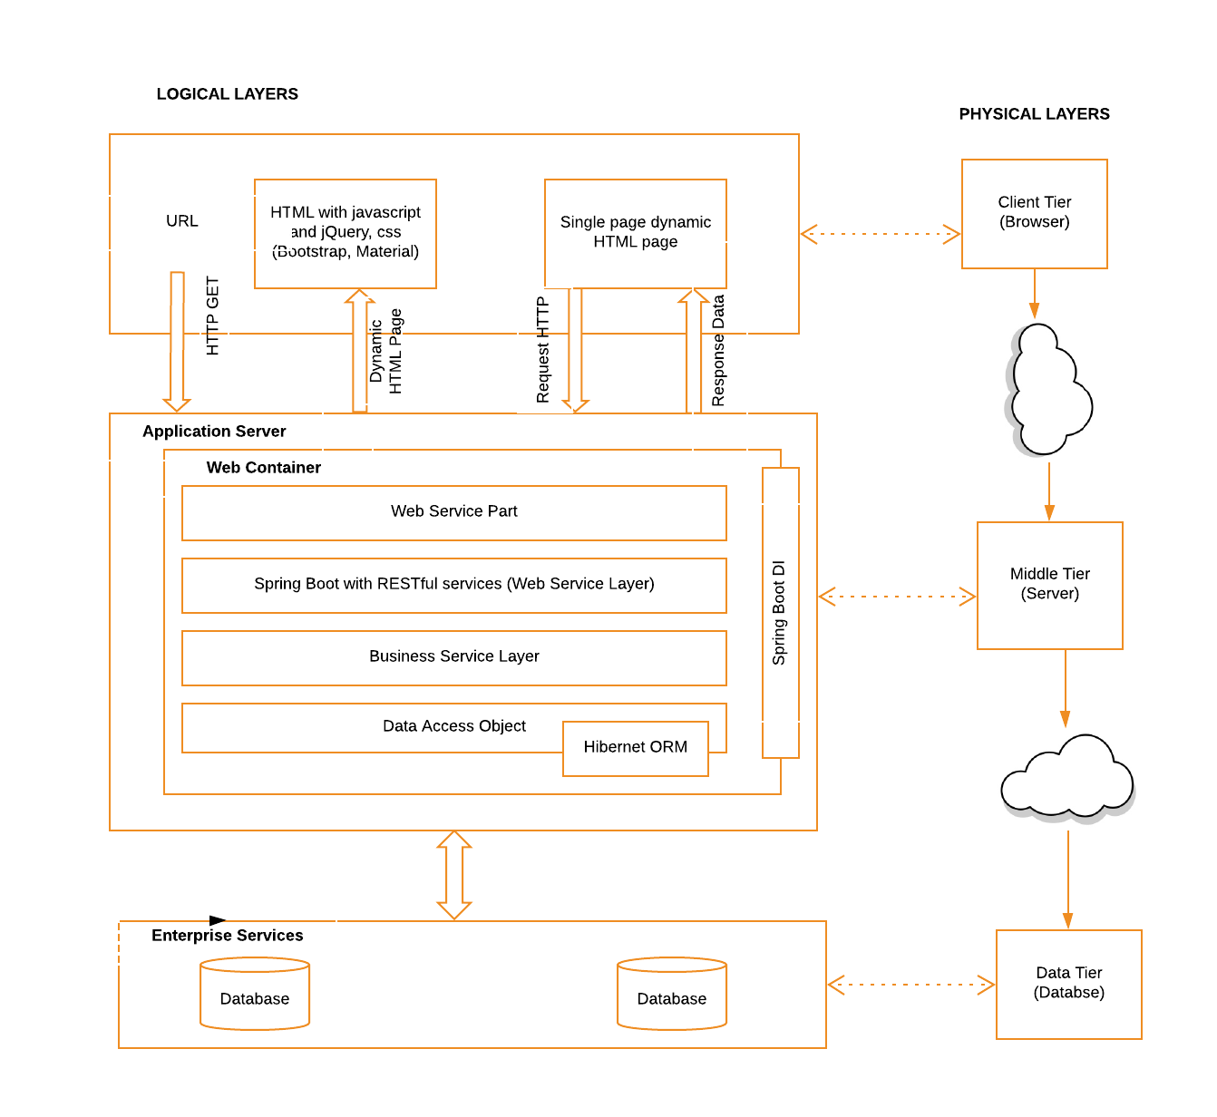
Detail System Architecture

Slide 8
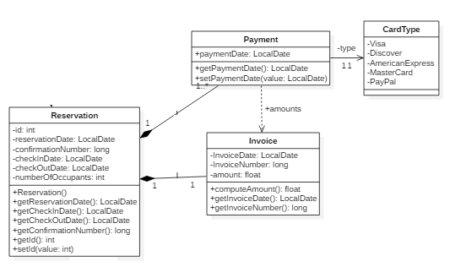
Class Diagram –quick look

Slide 9
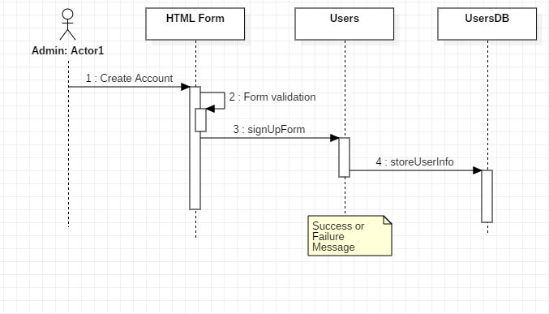
Sequence Diagram - Registration

Slide 10
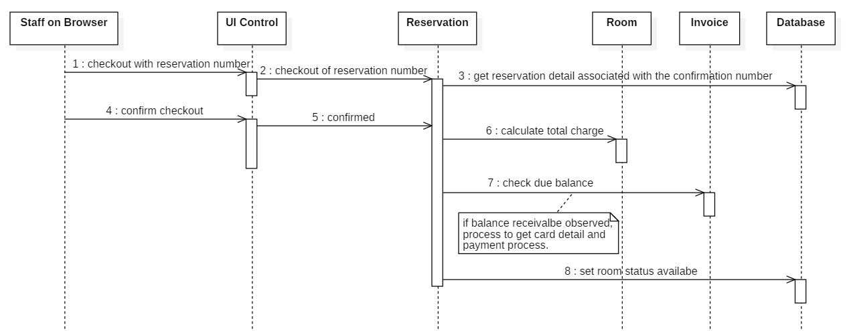
Sequence Diagram - Checkout

Slide 11
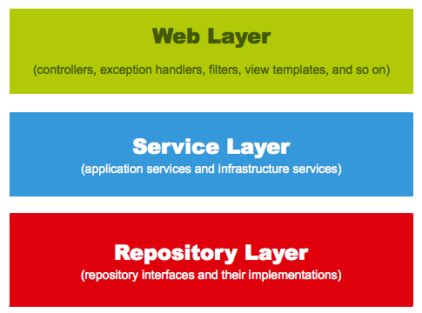
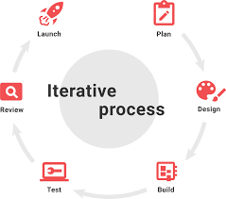
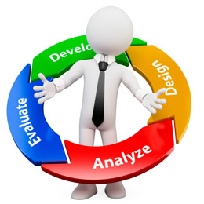
Design Approach and Model
Spring Boot - MVC
Agile and RUP

Slide 12
Summary
Perfect Bridge between the Customer and Hotel
Hotel data management and report generation

Slide 13
Thank You!!!
Any Questions ??

